Slide 1


Quality Attributes
Jan 2015
This document is confidential and contains proprietary information, including trade secrets of CitiusTech. Neither the document nor any of the information contained in it may be reproduced or disclosed to any unauthorized person under any circumstances without the express written permission of CitiusTech.

Slide 2
Introduction
Quality Attributes are also known as Non-functional requirements
Non-functional requirements are different from functional requirements in many ways.
Functional requirements:
Describe what a system should do.
Mostly come from the customer.
Can be described by a use case model and set of formal “shall” statements.
Non-functional requirements:
Are not related to individual use cases, but rather to system-wide attributes like performance.
Can be complete show-stoppers if not met.
Often conflict with each other, requiring tradeoffs.
Are more architecture-dependent than functional requirements.
Are often determined by the architect and stakeholders within the organization.
Can be described in terms of standard quality attributes.

Slide 3
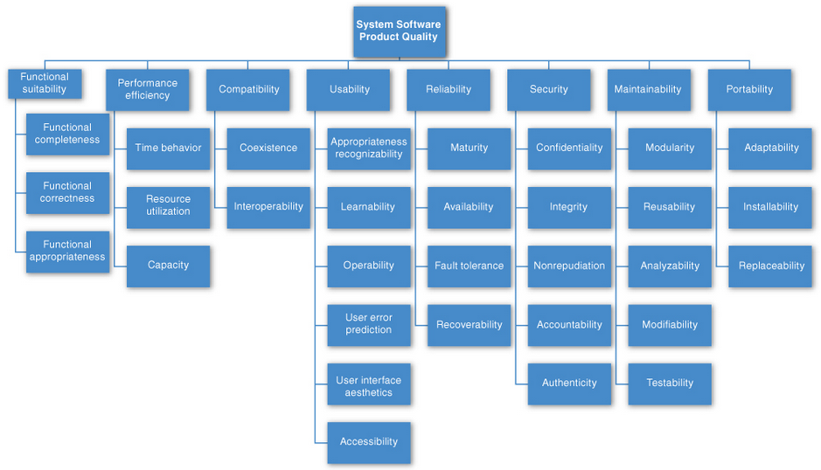
Standard Quality Attributes
Architects have no shortage of lists of quality attributes for software systems at their disposal. The “ISO/IEC FCD 25010: Systems and software engineering—Systems and software product Quality Requirements and Evaluation (SQuaRE)—System and software quality models” is a good example

Slide 4
Standard Quality Attributes : Functional Suitability
Functional Suitability
This characteristic represents the degree to which a product or system provides functions that meet stated and implied needs when used under specified conditions. This characteristic is composed of the following sub characteristics:
Functional completeness Degree to which the set of functions covers all the specified tasks and user objectives.
Functional correctness Degree to which a product or system provides the correct results with the needed degree of precision.
Functional appropriateness Degree to which the functions facilitate the accomplishment of specified tasks and objectives.

Slide 5
Standard Quality Attributes : Performance efficiency
Performance efficiency
This characteristic represents the performance relative to the amount of resources used under stated conditions. This characteristic is composed of the following sub characteristics:
Time behaviour Degree to which the response and processing times and throughput rates of a product or system, when performing its functions, meet requirements.
Resource utilization Degree to which the amounts and types of resources used by a product or system, when performing its functions, meet requirements.
Capacity Degree to which the maximum limits of a product or system parameter meet requirements.

Slide 6
Standard Quality Attributes : Compatibility
Compatibility
Degree to which a product, system or component can exchange information with other products, systems or components, and/or perform its required functions, while sharing the same hardware or software environment. This characteristic is composed of the following sub characteristics:
Co-existence Degree to which a product can perform its required functions efficiently while sharing a common environment and resources with other products, without detrimental impact on any other product.
Interoperability Degree to which two or more systems, products or components can exchange information and use the information that has been exchanged.

Slide 7
Standard Quality Attributes : Usability
Usability
Degree to which a product or system can be used by specified users to achieve specified goals with effectiveness, efficiency and satisfaction in a specified context of use. This characteristic is composed of the following sub characteristics:
Appropriateness recognizability Degree to which users can recognize whether a product or system is appropriate for their needs.
Learnability degree to which a product or system can be used by specified users to achieve specified goals of learning to use the product or system with effectiveness, efficiency, freedom from risk and satisfaction in a specified context of use.
Operability Degree to which a product or system has attributes that make it easy to operate and control.
User error protection Degree to which a system protects users against making errors.
User interface aesthetics Degree to which a user interface enables pleasing and satisfying interaction for the user.
Accessibility Degree to which a product or system can be used by people with the widest range of characteristics and capabilities to achieve a specified goal in a specified context of use.

Slide 8
Standard Quality Attributes : Reliability
Reliability
Degree to which a system, product or component performs specified functions under specified conditions for a specified period of time. This characteristic is composed of the following sub characteristics:
Maturity Degree to which a system, product or component meets needs for reliability under normal operation.
Availability Degree to which a system, product or component is operational and accessible when required for use.
Fault tolerance Degree to which a system, product or component operates as intended despite the presence of hardware or software faults.
Recoverability Degree to which, in the event of an interruption or a failure, a product or system can recover the data directly affected and re-establish the desired state of the system.

Slide 9
Standard Quality Attributes :Security
Security
Degree to which a product or system protects information and data so that persons or other products or systems have the degree of data access appropriate to their types and levels of authorization. This characteristic is composed of the following sub characteristics:
Maturity Degree to which a system, product or component meets needs for reliability under normal operation.
Confidentiality Degree to which a product or system ensures that data are accessible only to those authorized to have access.
Integrity Degree to which a system, product or component prevents unauthorized access to, or modification of, computer programs or data.
Non-repudiation degree to which actions or events can be proven to have taken place, so that the events or actions cannot be repudiated later.
Accountability Degree to which the actions of an entity can be traced uniquely to the entity.
Authenticity Degree to which the identity of a subject or resource can be proved to be the one claimed.

Slide 10
Standard Quality Attributes : Maintainability
Maintainability
This characteristic represents the degree of effectiveness and efficiency with which a product or system can be modified to improve it, correct it or adapt it to changes in environment, and in requirements. This characteristic is composed of the following sub characteristics:
Modularity Degree to which a system or computer program is composed of discrete components such that a change to one component has minimal impact on other components.
Reusability Degree to which an asset can be used in more than one system, or in building other assets.
Analyzability Degree of effectiveness and efficiency with which it is possible to assess the impact on a product or system of an intended change to one or more of its parts, or to diagnose a product for deficiencies or causes of failures, or to identify parts to be modified.
Modifiability Degree to which a product or system can be effectively and efficiently modified without introducing defects or degrading existing product quality.
Testability Degree of effectiveness and efficiency with which test criteria can be established for a system, product or component and tests can be performed to determine whether those criteria have been met.

Slide 11
Standard Quality Attributes : Portability
Portability
Degree of effectiveness and efficiency with which a system, product or component can be transferred from one hardware, software or other operational or usage environment to another. This characteristic is composed of the following sub characteristics:
Adaptability Degree to which a product or system can effectively and efficiently be adapted for different or evolving hardware, software or other operational or usage environments.
Installability Degree of effectiveness and efficiency with which a product or system can be successfully installed and/or uninstalled in a specified environment.
Replaceability Degree to which a product can replace another specified software product for the same purpose in the same environment.

Slide 12
Standard Quality Attributes - Advantages
Advantages
They can be helpful checklists to assist requirements gatherers in making sure that no important needs were overlooked. Even more useful than standalone lists, they can serve as the basis for creating your own checklist that contains the quality attributes of concern in your domain, your industry, your organization, and your products. Quality attribute lists can also serve as the basis for establishing measures.
these lists force architects to pay attention to every quality attribute on the list, even if only to finally decide that the particular quality attribute is irrelevant to their system.

Slide 13
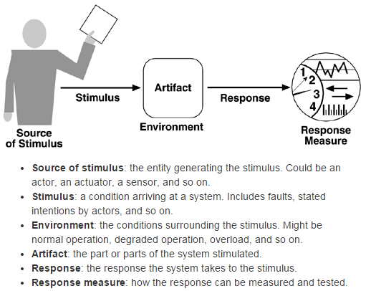
Quality Attribute Scenarios
Quality attribute scenarios capture non-functional requirements of a system in terms of standard quality attributes, such as Availability, Modifiability, and so on. These are independent of specific functional requirements and describe desired qualities of a system. The qualities are stated in terms of a desired system response to some stimulus; more formally, a 6-part formulation is used.
As an architecture is created or modified, the quality attribute scenarios should guide the decisions and tradeoffs made.

Slide 14
Performance Quality Attribute Scenarios Template
Motivation / Business Goals Supported
Application fast enough to be usable, application can meet business needs
Details
Scenario Portion | Possible Values
Source | A number of sources both external and internal
Stimulus | Periodic events, sporadic events, stochastic events
Artifact | System, or possibly a component
Environment | Normal mode; overload mode
Response | Process stimuli; change level of service
Response Measure | Latency, deadline, throughput, jitter, miss rate, data loss

Slide 15
Security Quality Attribute Scenarios Template
Motivation / Business Goals Supported
Ensuring data integrity, Satisfying regulations, Ensuring customer confidence in product
Details
Scenario Portion | Possible Values
Source | User/system who is legitimate/imposter/unknown with full/limited access
Stimulus | Attempt to display/modify data; access services
Artifact | System services, data
Environment | Normal operation; degraded (failsafe) mode
Response | Authenticate user; hide identity of user; grant/block access; encrypt data; detect excessive demand…
Response Measure | Time /effort/resources to circumvent security measures with probability of success

Slide 16
Usability Quality Attribute Scenarios Template
Motivation / Business Goals Supported
Ensure users can accomplish tasks in system; reduce barriers to system adoption
Details
Scenario Portion | Possible Values
Source | End user
Stimulus | Wants to: learn system, use system, recover from errors, adapt system, feel comfortable
Artifact | System
Environment | At runtime, or configure time, install-time
Response | To learn system Help system is context sensitive Interface familiar, consistent …continued

Slide 17
Usability Quality Attribute Scenarios Template
Scenario Portion | Possible Values
Response | To learn system Help system is context sensitive Interface familiar, consistent To use system efficiently Reuse of command or data already entered Navigation support, comprehensive searching To recover from errors Undo, cancel, recover from system failures forgotten passwords To adapt system: customize the system to user liking To feel comfortable
Response Measure | Task time, number of errors, number of tasks accomplished, user satisfaction, gain of user knowledge, amount of time/data lost

Slide 18
Availability Quality Attribute Scenarios Template
Motivation / Business Goals Supported
Mission-critical application, ensuring users have access to data, maintaining user confidence in product
Details
Scenario Portion | Possible Values
Source | Internal to system or external to system
Stimulus | Crash, omission, timing, no response, incorrect response
Artifact | System’s processors, communication channels, persistent storage
Environment | Normal operation; degraded (failsafe) mode
Response | Log the failure, notify users/operators, disable source of failure, continue (normal/degraded)
Response Measure | Time interval available, availability%, repair time, unavailability time interval

Slide 19
References
Software Architecture in Practice, Third Edition

Slide 20
Thank You

